Slide 1

Video Game Presentation
Bawan Breath of the wild
Grp Name:

Slide 2




OUR TEAM
Mahmoud Cheikh
Ahmed Elmoez Noomen
Hazem Rjaibi
Raed Geusmi
Houssem Landoulsi

Slide 3

Contents
Coat Of Arms
01
Characters
02
Story
03
Menu
04
the meaning behind it.
Pictures+Physical description/Personality traits +Role and Actions in the story
Plot + Setting

Slide 4

Game Overview
Our game is an adventure game . We aim for it to be fun and and we have a masseage to pass in our game . the player can be amused and acquire many things about the story during the game .

Slide 5
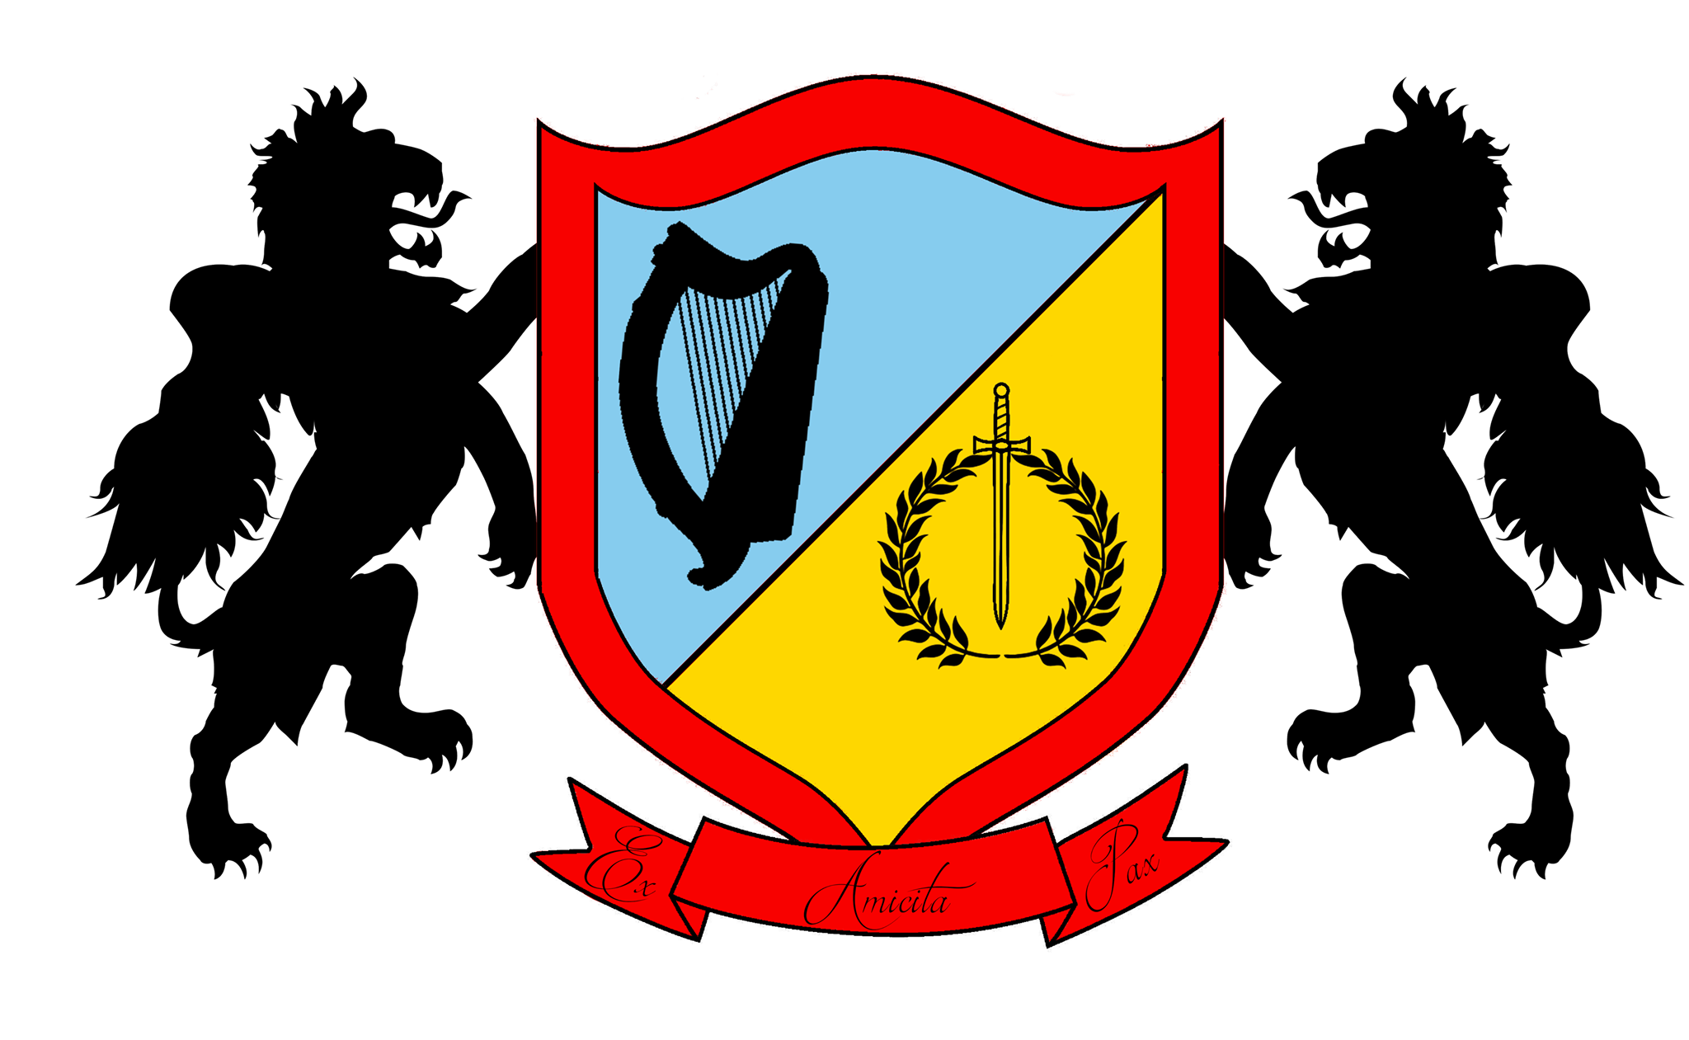
Coat Of Arms
The Two Lions
The Two Lions
Bleu Color : It symbolizes trust, loyalty, wisdom, confidence, intelligence, faith, truth
Yellow Color : On one hand yellow stands for freshness, happiness, positivity, clarity, energy, optimism, enlightenment, remembrance, intellect, honor, loyalty, and joy
Motto
A known symbol of leadership.
A known symbol of constancy.
Red Color : it is associated with energy, war, danger, strength, power, determination as well as passion

Slide 6
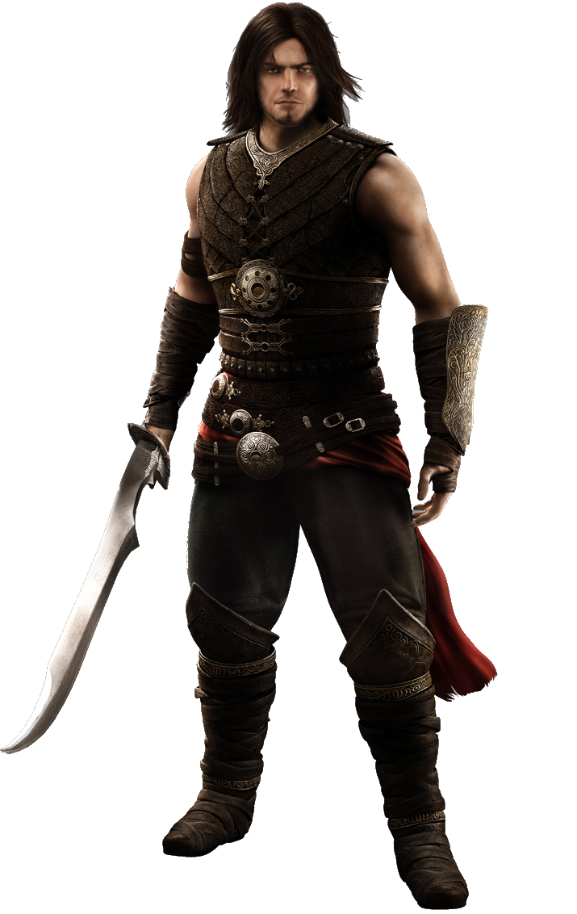
Characters
Bawan
Main Character.
Age: 25
Height & Weight: 1’89 & 95Kg
+:Intelligence
+:Physical Power

Slide 7
Characters
Shirren
Main Character.
Age: The Age of The Universe
Height & Weight: Unkown
Unkown:Physical Power

Slide 8
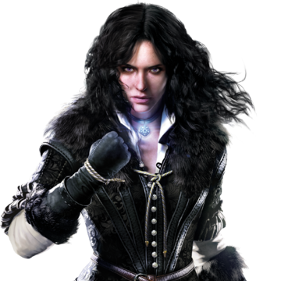
Characters
Angel
The Princess
Age: 22
Height & Weight: 1’69 59Kg
Objective : Keeping Peace in Pearce Land

Slide 9

STORY
Long before humans came to be, there existed a primordial spirit that sought only one thing ; to become everything . However, it's desire was only the stuff of imagination, for many a pure spirit retaliated against it and waged war for the sake of every other beings. Eons passed and the war never seemed to end. Ultimately, the pure spirits decided that in order to come out of the war as the victors they needed to do what has never been done before. Countless spirits assembled, taking up an immense space far beyond what the eye can see, and they merged into one single powerful entity. And thus, THE LIGHT SPIRIT was born. Now the idea of winning the war was not impossible. The light spirit clashed with it's dark counterpart in a battle that shook the universe. After a grueling fight that seemed to never end, the light spirit overpowered it's dark enemy and imprisoned it in a cosmic prison.

Slide 10
SHIREEN as the light spirit named it, was no more...or so it seemed . The light spirit fore-saw that SHIRREN, being the embodiment of chaos and discord, would never be truly be stopped and that one day, he shall return and so it disassembled the key to SHIRREN's prison and scattered it in every corner of a then-insignificant planet called earth. Victory however didn't come cheap, for the light spirit RAAVA, as it would later be called, was weakened by the war and it's form couldn't hold itself together and thus, RAAVA's very essence dissipated into the universe, waiting for a worthy warrior to emerge and fuse with her to stop SHIREEN once again.
As for the pieces of the key, humans soon realized that each piece granted it's bearer great power which is to be expected, for every piece held within it a fragment of RAAVA's power.

Slide 11
The crimelord named Bardack was granted powers that he used to wreak havoc on earth. One day, Forst was ordered by SHIREEN to kidnap the Princess and use the key to set him free, and so, Bardack obeyed and did what he was ordered to do. Without the Princess to enforce law, chaos became everywhere with heinous crimes committed everyday. The ever growing chaos on earth only served to gain SHIREEN more power and concordantly, weaken RAAVA even more. The latter knew it was time to merge with a great warrior to fight SHIREEN in a battle that will decide the fate of the universe for countless years to come. And so she did merge with a Knight called BAWAN who has proven to be a legendary leader, fighting the evergrowing chaos. BAWAN, being a descendant of one the first humans to bear a piece of the key, inherited the ability to sence the key's power and he set out on a journey to rescue the Princess and restore harmony using his newly grated powers from his merger with RAAVA.
The Day has Come , The Plan Of SHIRREN Will be implemented , Angel The Princess was kidnapped and SHIREEN Declared war and he will destroy the kingdoms including the City Pearce where our hero Bawan is situated . Bawan and His Friends know SHIREEN has kidnapped angel and they are ready to defend earth. This will be thier final battle , they must save angel or everything will be destroyed and the world will be ruled by SHIRREN , By The Evil Force ...

Slide 12
ENDING.
Bawan Will Try To Save The Princess And The Fate Of The Earth From The Shirren .

Slide 13

SETTING (In The Cinematic)
Shirren’s Castle
A Dark Castle Where Shirren wants to rule the world and destroy everything .
The place were everything begin when shirren’s plan will happend .

Slide 14

SETTING ( During The Gameplay )
1:
Level 1
2: The Jungle
Level 2
3:Shirren’s Castle
Level 3
4: The Hell
Level Boss

Slide 15
Menu
Mahmoud Menu 3andek

Slide 16
THANKS
Does anyone have any questions?
facebook.com/
@

